Slide 1
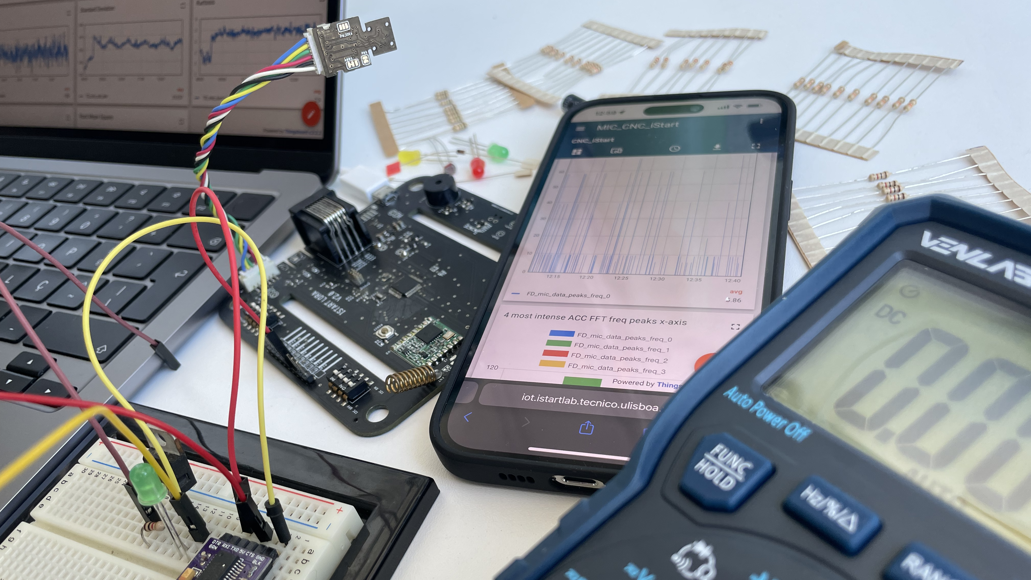

Smart Home Stock
ElectroCap Project Proposal
Ricardo Fiúza
Rafaela Pereira
Renato Simões
Vera Amaral
Henrique Simões
Leonor Mira

Slide 2
1. Advisors and Mentor
Scientific Advisor: Prof. António Grilo
Scientific Co-advisor:
Coordinator: Prof.ª Teresa Vazão
Mentor:

Slide 3
2. Problem definition
What are the problems to solve?:
Not knowing efficiently and effectively, what kind of items (and their respective quantity) people have inside their homes.
Possible consequences of the problem:
Unnecessary purchases or items running out unexpectedly.
Unnecessary Food waste.

Slide 4
2. Problem definition
Biggest costs for the solution to be implemented:
Money.
Space to implement this technology within people's homes (overlooking the necessity to have a home).
Mobile device to access their stock information from anywhere any time
"Less-better" solution to reduce the costs:
Doesn't cost money nor occupies any home space.
Only uses the application to regulate manually what people have or do not have (no automatic features).

Slide 5
3. Solution beneficiaries
Household Members:
Benefit: Improved organization and awareness of available food supplies.
Outcome: Reduced instances of running out of essential items, decreased food waste, and increased efficiency in meal planning.
Grocery Shoppers:
Benefit: Streamlined shopping experience with a more accurate and personalized shopping list.
Outcome: Time and cost savings, as well as a more focused and efficient shopping process.

Slide 6
3. Solution beneficiaries
Environmental Advocates:
Benefit: Reduction in food waste contributes to environmental sustainability.
Outcome: A positive impact on ecological footprints, as fewer resources are used to produce and dispose of wasted food.
App Developers:
Benefit: Recognition and success in creating a useful and innovative application.
Outcome: Opportunities for additional projects and collaborations in the technology sector.

Slide 7
4. Technological solution
Our containers are designed for various types of items, specially food, and are equipped with technology to estimate the quantity in each container. SHS starts functioning effectively after a few uses, where it calculates the average usage of each food item per meal. This data forms the basis for estimating the remaining quantity of each item.
The system is complemented by a mobile application accessible from anywhere. The app displays a comprehensive list of stored food items along with their names and quantities. When the quantity of a particular food item falls below a predefined threshold (either in terms of meals or a specific value), the app sends a notification and automatically adds that item to the shopping list.
From this technology, we aim to reduce instances of running out of essential items, decrease food waste and increase efficiency in meal planning.

Slide 8
5. Competitors and previous work
Competitors: Companies like Samsung and LG offer similar products.
Previous work: Smart fridge is an example of products delivered in the past.

Slide 9
6. Solution requirements
Accurate Monitoring:
The SHS must be able to accurately monitor the quantity of each stored food item. This may involve the use of weight sensors or other technologies to estimate the amount of food consumed in each meal.
Connectivity with Mobile App:
The solution should integrate with a mobile app that allows users to view the content of each container, estimated quantities, and replenishment alerts. The synchronization between the physical device and the app should be fast and reliable.

Slide 10
6. Solution requirements
Estimation of Remaining Meals:
The system should be capable of calculating and clearly presenting in the app the estimate of the number of meals that can still be prepared with the available food. This estimate should be dynamic and updated based on recent consumption.
Automatic Alerts and Shopping Lists:
The mobile app should provide alerts when the quantity of a particular food item is below a predefined threshold. Additionally, the system should automatically generate a shopping list based on items that need replenishing.

Slide 11
7. Technical challenges
Sensor Accuracy and Reliability:
Challenge: Ensuring that sensors accurately measure and estimate the quantity of food items used in each meal.
Solution: Implementing robust sensor technologies and calibration mechanisms to enhance accuracy and reliability.
Data Security and Privacy:
Challenge: Safeguarding user data stored in the app and ensuring that sensitive information is protected.
Solution: Implementing encryption protocols, secure data storage practices, and providing clear privacy policies to users.

Slide 12
7. Technical challenges
Compatibility with Various Containers:
Challenge: Designing the SHS to be compatible with different types and sizes of food containers.
Solution: Developing a versatile system that can adapt to various storage habits and container materials.
Wireless Communication Stability:
Challenge: Ensuring stable and reliable communication between smart containers and the mobile app.
Solution: Employing robust wireless communication protocols and addressing potential interference or connectivity issues.

Slide 13
7. Technical challenges
App Usability and User Experience:
Challenge: Creating an intuitive and user-friendly app interface to encourage consistent usage.
Solution: Conducting user testing, gathering feedback, and continuously refining the app's design for optimal usability.
Algorithm Accuracy for Meal Estimation:
Challenge: Developing algorithms that accurately estimate the quantity of food used per meal.
Solution: Iterative testing, refining algorithms based on real-world usage data, and incorporating machine learning for continuous improvement.

Slide 14
8. Partners
As of today, the Smart Home Stock (SHS) team, doesn't have any partnership, but we definitely look forward to improve our connections and partnerships in the near future.

Slide 15
9. Testing and validation metrics
Defect Density:
Definition: Number of defects identified per unit of code or functionality.
Purpose: Measures the quality of the codebase and identifies areas that might need improvement.
Execution Time:
Definition: The time taken to execute a set of test cases.
Purpose: Measures the efficiency of the testing process.

Slide 16
9. Testing and validation metrics
Usability Testing Metrics:
Definition: Metrics related to the ease of use, user interface effectiveness, and overall user experience.
Purpose: Evaluates the product's usability and user-friendliness
User Satisfaction:
Definition: Feedback or survey results from end-users regarding their satisfaction with the product.
Purpose: Measures how well the product meets user expectations and needs.

Slide 17
10. Division of labor (I)
Ricardo Fiúza | Rafaela Pereira | Renato Simões
Leader | Co-Leader | Team Member
Search for Partners | Wireless communication between recipients and app (Responsible) | Prototype Modelling (Responsible)
Hardware Development and Management (Responsible) | Hardware Development and Management | Modelling of Various Food Containers (Responsible)
Prototype Modelling | Prototype Modelling | Hardware Development and Management
Testing Project | Testing Project | Testing Project

Slide 18
11. Division of labor (II)
Vera Amaral | Henrique Simões | Leonor Mira
Team Member | Team Member | Team Member
Web Development and Management (Responsible) | App Development (Responsible) | Image Design (Responsible)
Hardware Development and Management | Hardware Development and Management | Hardware Development and Management
Testing Project | Web Development and Management | Web Development and Management
 | Testing Project (Responsible) | Testing Project

Slide 19
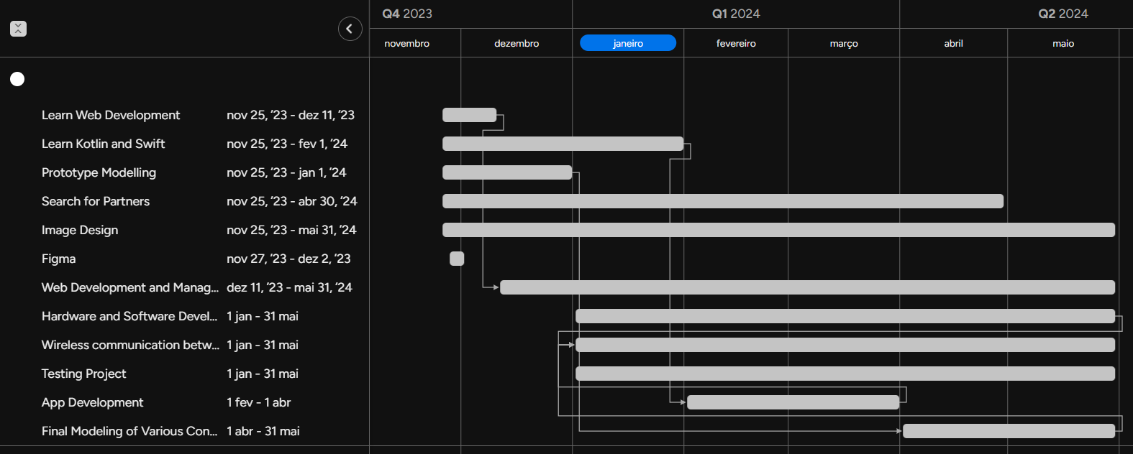
12. Schedule

Slide 20
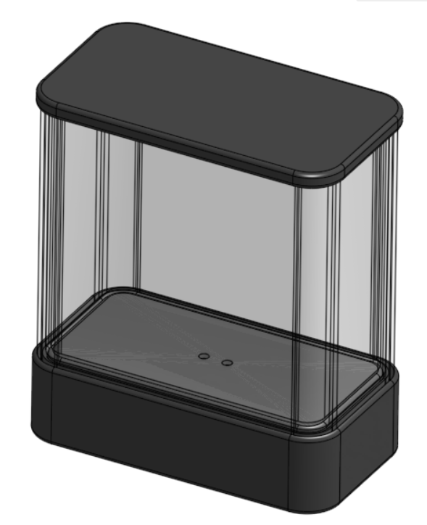
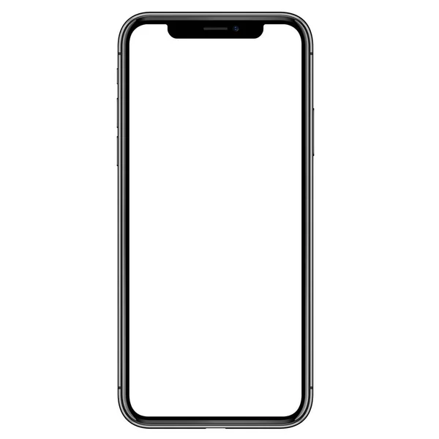
15. System Graphic Representation
Cloud Server
Quantity of what the container contains & pairing with containers
Quantity of what it contains & pairing with APP
User's input from APP
User's input from APP
Device
Container

Slide 21
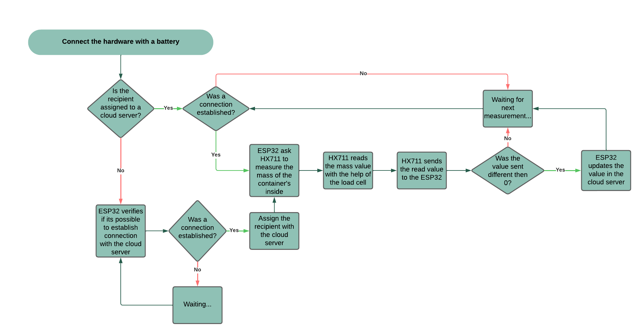
13. Block diagram: Weight Container

Slide 22
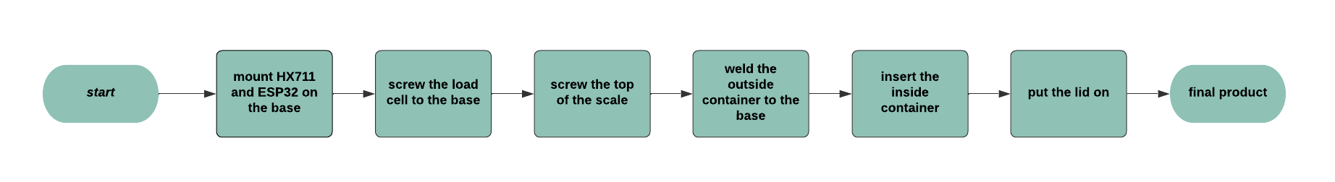
14. Block diagram: Weight Container Assembly

Slide 23
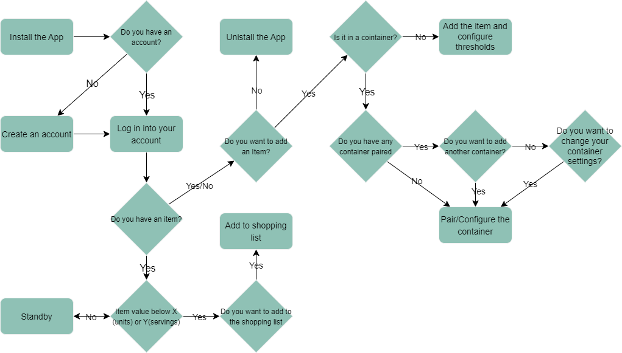
16. Block diagram: App

